Slide 1

Image segmentation: U-Net
UNet is a convolutional neural network (CNN) architecture designed primarily for biomedical image segmentation, introduced in 2015. It follows a U-shaped structure with an encoder-decoder design.
The encoder (contracting path) consists of convolutional and pooling layers that progressively extract spatial features and reduce the image size, similar to a traditional CNN.
The decoder (expanding path) uses upsampling and skip connections to restore spatial resolution while maintaining fine details, enabling precise segmentation.
Skip connections link corresponding layers from the encoder to the decoder, preserving spatial information and allowing the network to learn both global and local features.
Olaf Ronneberger, Philipp Fischer, Thomas Brox, U-Net: Convolutional Networks for Biomedical Image Segmentation, MICCAI 2015
Machine Learning Methods for Biomedical Data (D012554)

Slide 2
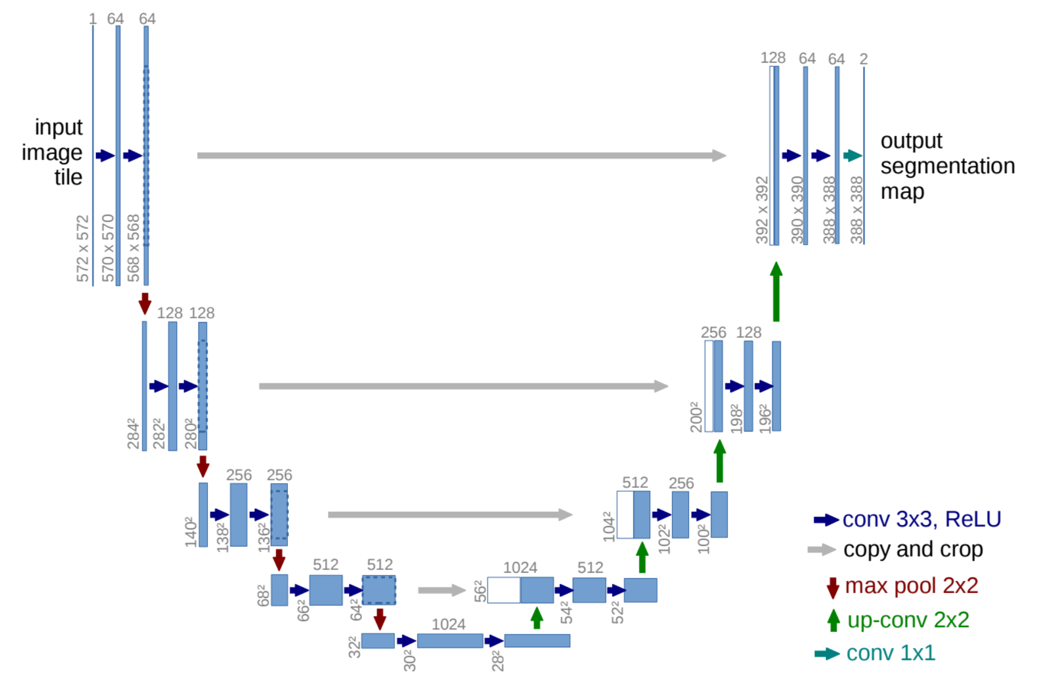
Image segmentation: U-Net
Olaf Ronneberger, Philipp Fischer, Thomas Brox, U-Net: Convolutional Networks for Biomedical Image Segmentation, MICCAI 2015
Machine Learning Methods for Biomedical Data (D012554)

Slide 3
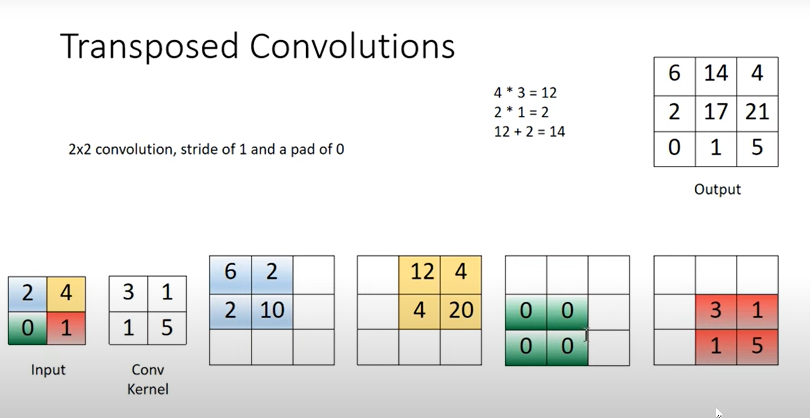
Image segmentation: U-Net
Olaf Ronneberger, Philipp Fischer, Thomas Brox, U-Net: Convolutional Networks for Biomedical Image Segmentation, MICCAI 2015
Machine Learning Methods for Biomedical Data (D012554)

Slide 4
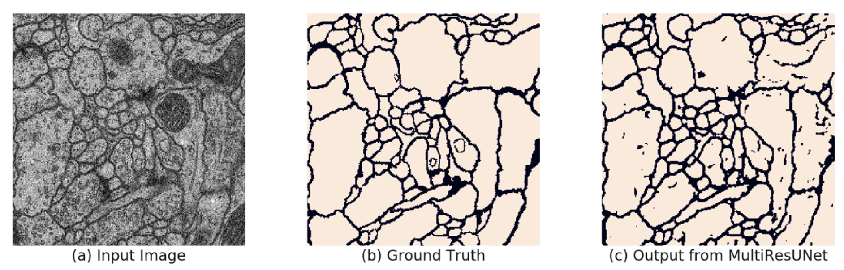
Image segmentation: U-Net
Olaf Ronneberger, Philipp Fischer, Thomas Brox, U-Net: Convolutional Networks for Biomedical Image Segmentation, MICCAI 2015
Machine Learning Methods for Biomedical Data (D012554)

Slide 5
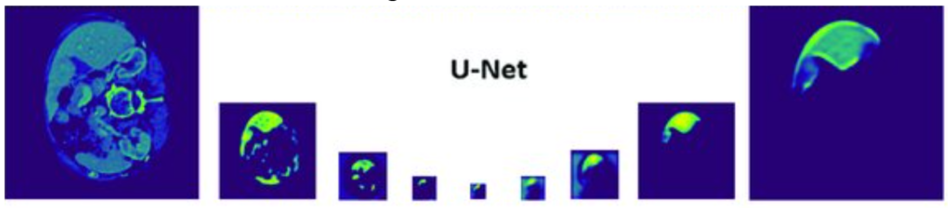
Image segmentation: U-Net
Apply U-Net to segment relevant regions in an image first, then use the segmented output to classify the image based on the presence, shape, or characteristics of the detected regions.
Olaf Ronneberger, Philipp Fischer, Thomas Brox, U-Net: Convolutional Networks for Biomedical Image Segmentation, MICCAI 2015
Machine Learning Methods for Biomedical Data (D012554)

Slide 6

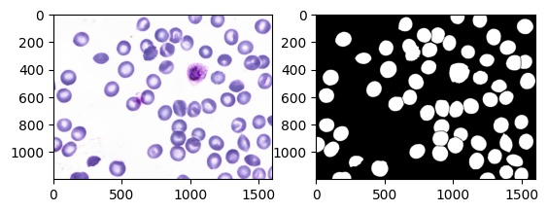
U-Net
unet-blood-cell-segmentation.ipynb
Machine Learning Methods for Biomedical Data (D012554)

Slide 7
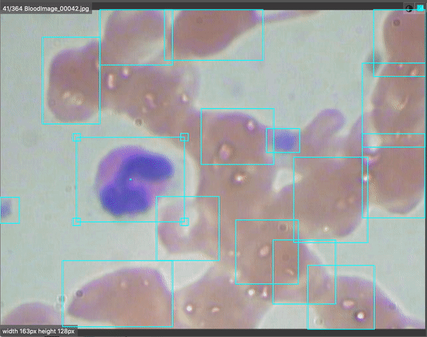

Object recognition: YOLO (You Only Look Once)
Redmon, J., Divvala, S., Girshick, R., & Farhadi, A. (2016). You Only Look Once: Unified, Real-Time Object Detection. CVPR
Machine Learning Methods for Biomedical Data (D012554)

Slide 8
Object recognition: YOLO (You Only Look Once)
Grid-based detection: The image is divided into an S×S grid, where each grid cell is responsible for predicting objects whose centers fall within it.
Bounding box and class predictions: Each grid cell predicts B bounding boxes (with coordinates, width, height, and confidence scores) and C class probabilities, all in a single tensor.
Non-maximum suppression (NMS): To eliminate redundant detections, YOLO applies NMS, keeping only the highest-confidence bounding boxes while discarding overlapping ones.
Single-pass object detection: YOLO processes the entire image in one forward pass through a deep neural network, making it extremely fast.
Redmon, J., Divvala, S., Girshick, R., & Farhadi, A. (2016). You Only Look Once: Unified, Real-Time Object Detection. CVPR
Machine Learning Methods for Biomedical Data (D012554)

Slide 9
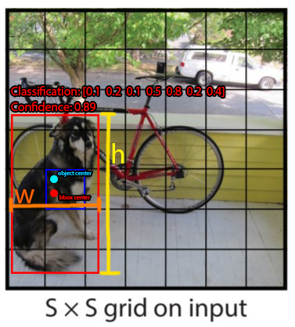
Object recognition: YOLO (You Only Look Once)
Grid-based detection: The image is divided into an S×S grid, where each grid cell is responsible for predicting objects whose centers fall within it.
Redmon, J., Divvala, S., Girshick, R., & Farhadi, A. (2016). You Only Look Once: Unified, Real-Time Object Detection. CVPR
Machine Learning Methods for Biomedical Data (D012554)

Slide 10
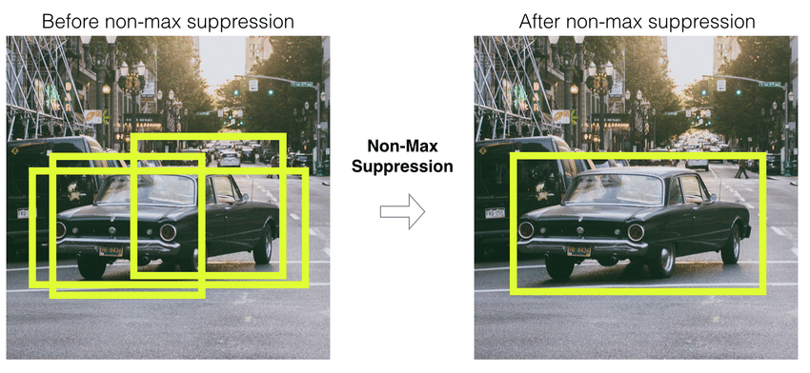
Object recognition: YOLO (You Only Look Once)
Non-maximum suppression (NMS): To eliminate redundant detections, YOLO applies NMS, keeping only the highest-confidence bounding boxes while discarding overlapping ones.
Redmon, J., Divvala, S., Girshick, R., & Farhadi, A. (2016). You Only Look Once: Unified, Real-Time Object Detection. CVPR
Machine Learning Methods for Biomedical Data (D012554)

Slide 11
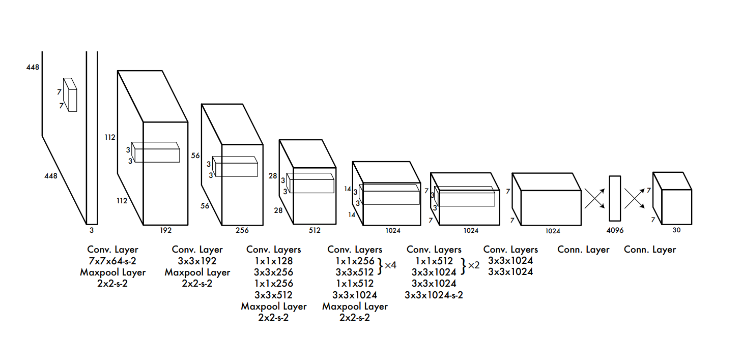
Object recognition: YOLO (You Only Look Once)
Single-pass object detection: YOLO processes the entire image in one forward pass through a deep neural network, making it extremely fast.
The final output of YOLO is a tensor of shape (S, S, B × (5 + C)), meaning:
Each (i, j) position in this output tensor corresponds to the (i, j) grid cell in the original image.
Each grid cell contains B bounding boxes, each predicting:
Object’s center (x, y)
Size (w, h)
Confidence score
Class probabilities (C classes)
Redmon, J., Divvala, S., Girshick, R., & Farhadi, A. (2016). You Only Look Once: Unified, Real-Time Object Detection. CVPR
Machine Learning Methods for Biomedical Data (D012554)

Slide 12
Common Objects in Context dataset (COCO)
COCO is a large-scale dataset for object detection, segmentation, and captioning that contains over 330,000 images with 1.5 million object instances across 80 categories.
It includes bounding boxes, object masks (segmentation), keypoints for human poses, and dense image captions, making it highly versatile for multiple computer vision tasks.
Serves as a benchmark dataset for state-of-the-art object detection and segmentation models, including YOLO and other deep learning architectures.
Lin, T.-Y. et al. (2014). Microsoft COCO: Common Objects in Context. ECCV 2014, pp. 740–755.
Machine Learning Methods for Biomedical Data (D012554)

Slide 13
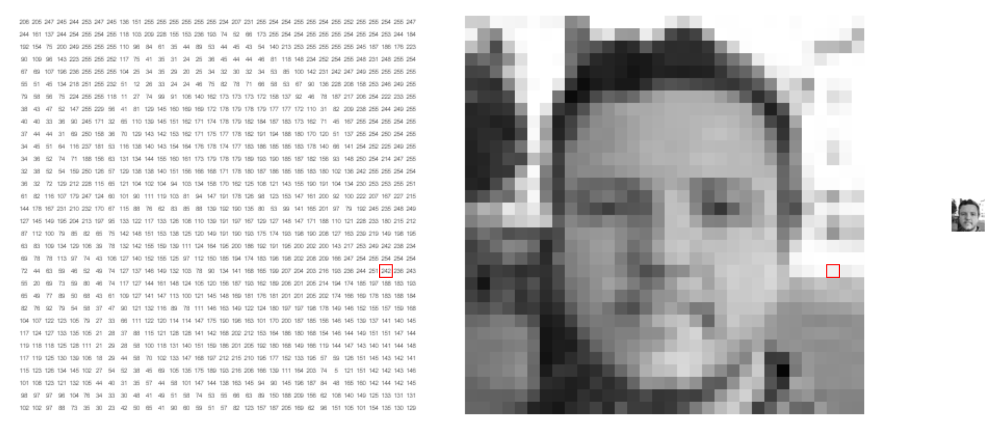
What computers see
Machine Learning Methods for Biomedical Data (D012554)
Notes:
Shifts
Scale
anngles
Shadows

Slide 14
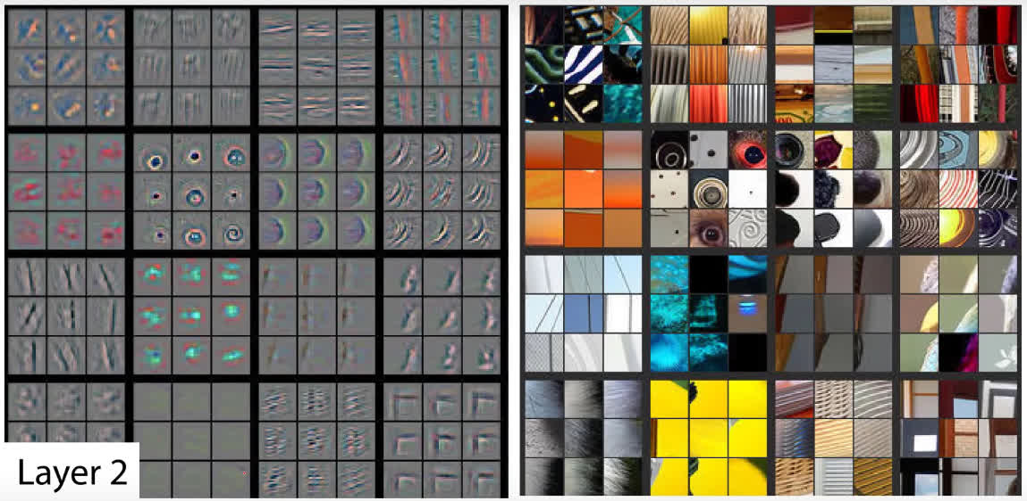
What computers see
On the left, each square is a different feature map (convolutional filter) with the activations shown for the corresponding images on the right (these images are selected such that they maximize the activation of the filter.
Zeiler, M. D., & Fergus, R. (2014, September). Visualizing and understanding convolutional networks. In European conference on computer vision (pp. 818-833)
Machine Learning Methods for Biomedical Data (D012554)
Notes:
Shifts
Scale
anngles
Shadows

Slide 15
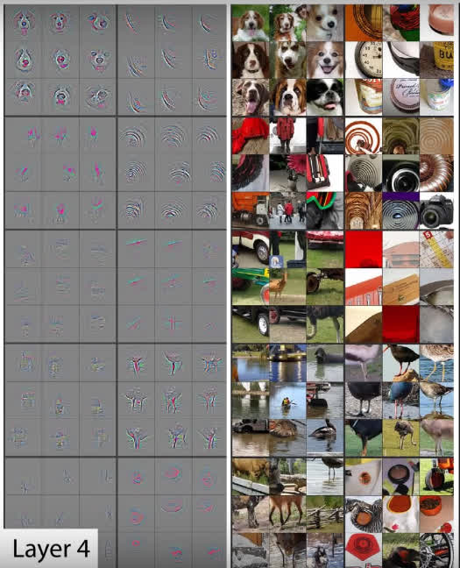
What computers see
The patterns that the filters detect become more complex as we go deeper into the network.
Zeiler, M. D., & Fergus, R. (2014, September). Visualizing and understanding convolutional networks. In European conference on computer vision (pp. 818-833)
Machine Learning Methods for Biomedical Data (D012554)
Notes:
Shifts
Scale
anngles
Shadows

Slide 16
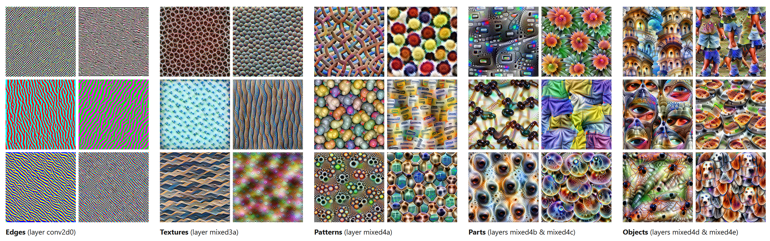
What computers see
https://distill.pub/2017/feature-visualization/
Machine Learning Methods for Biomedical Data (D012554)

Slide 17
Activation maximization
Activation Maximization is a technique used to visualize what a CNN has learned by generating an input that maximally activates a specific neuron or filter.
It involves optimizing an input image using gradient ascent to enhance the activation of a target neuron, layer, or class score while applying regularization techniques (e.g., total variation loss, L2 norm) to ensure interpretability.
Machine Learning Methods for Biomedical Data (D012554)
Notes:
https://www.youtube.com/watch?v=SCE-QeDfXtA

Slide 18
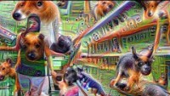
Activation maximization
Machine Learning Methods for Biomedical Data (D012554)
Notes:
https://www.youtube.com/watch?v=SCE-QeDfXtA

Slide 19
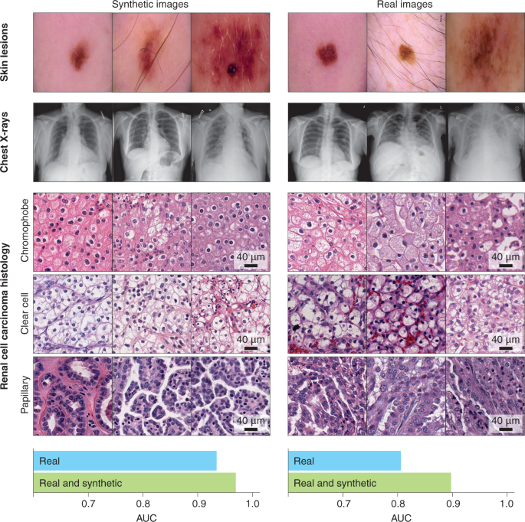
Activation maximization
X-rays, MRIs, pathology slides.
By generating synthetic images that maximally activate certain neurons, we can visualize the features a model uses to detect tumors, fractures, or diseased tissues.
Generating synthetic images offers an ethical alternative to using sensitive patient data, helping with education and training without compromising patient privacy
Machine Learning Methods for Biomedical Data (D012554)
Notes:
https://www.youtube.com/watch?v=SCE-QeDfXtA

Slide 20
Activation maximization
DNA/RNA sequences or protein structures: Generating synthetic sequences that maximize disease-associated neuron activations.
Optimizing molecular structures: Chemical structures or molecular fingerprints, e.g. revealing which molecular features trigger activation in neurons predicting drug activity.
Machine Learning Methods for Biomedical Data (D012554)
Notes:
https://www.youtube.com/watch?v=SCE-QeDfXtA

Slide 21
Transfer learning
Transfer learning is a machine learning technique where a pre-trained model, trained on a large dataset (e.g., ImageNet for vision or BERT for NLP), is adapted to a new but related task with limited data..
It significantly reduces training time and computational costs by leveraging previously learned features instead of training a model from scratch.
Common approaches include fine-tuning (modifying and retraining some layers) and feature extraction (using pre-trained layers as fixed feature detectors).
Pre-training positions a deep neural network closer to the optimal solution in the vast, high-dimensional model parameter space, enabling faster convergence and better performance compared to starting from random initialization.
Machine Learning Methods for Biomedical Data (D012554)
Notes:
https://www.youtube.com/watch?v=SCE-QeDfXtA

Slide 22
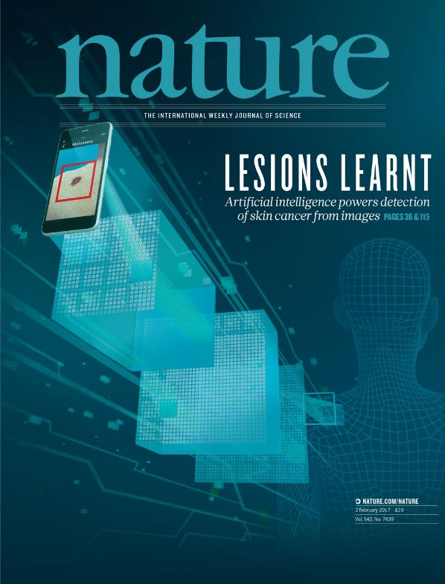
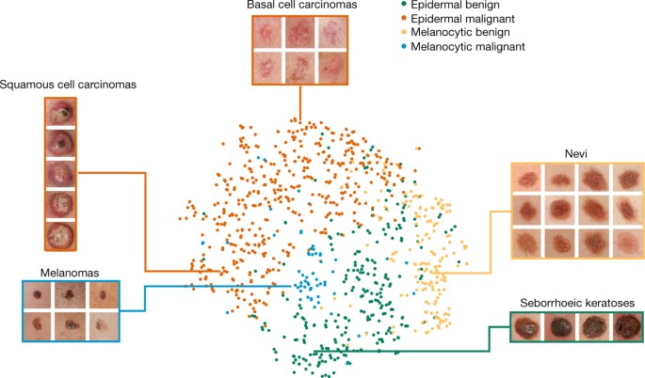
Transfer learning
Thrun et al., Dermatologist-level classification of skin cancer with deep neural networks, Nature (2017)
Machine Learning Methods for Biomedical Data (D012554)

Slide 23
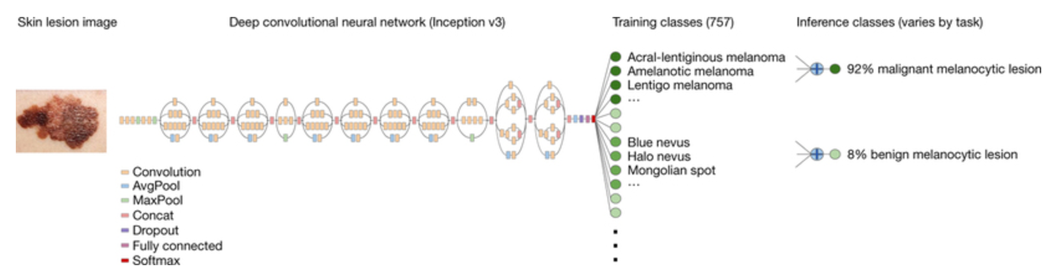
Transfer learning
A pre-trained (on ImageNet) Inception v3 CNN was downloaded from GitHub.
The fully connected feed forward neural network module was replaced.
The network was then fine-tuned on the available lesion data. This means that the remainder of the modelparameters were used as the network’s initialization.
Thrun et al., Dermatologist-level classification of skin cancer with deep neural networks, Nature (2017)
Machine Learning Methods for Biomedical Data (D012554)

